Slide 1

INTELLIGENT BIPED ANIMATION
Under
Dr. Marek Perkowski
By
Adel Alkharraz & Aniruddha Shahapurkar

Slide 2
Objectives
Getting familiar with ROS
Controlling the Dynamixel Servo motors
Creating a Guideline document for controlling the Dynamixel servos.
Demonstrate head/arms motions, and other emotional behaviors with whole body of the Robot.

Slide 3
Hardware
HR-OS5
HDMI to HDMI-C adaptor
3 pin power hub
U2D2 Adapter
12 Dyamixel MX-106 Servos
6 Dyamixel MX-64 Servos
2 Dyamixel MX-28 Servos

Slide 4
Software
Python 2.7
ROS
Linux Ubuntu 16.04
Dynamixel Wizard

Slide 5
HR-OS5 : Brief Introduction
The HR-OS5 Robot is for researchers and educators who are looking for a solid, high-performance, open-source humanoid robot platform to develop on.
Hardware Architecture:
1. Main CPU – Intel NUC D54250WYB SBC is used with Ubuntu 14.04 LTS Operating
System installed on it.
2. Sub-controller – Arbotix-Pro/CM-730 ARM sub-controller is used. It is the main interface of the Main CPU to the servos, sensors and communications.
3. Dynamixels – They are actuators which are present in the robot’s internal structure and joints.

Slide 6
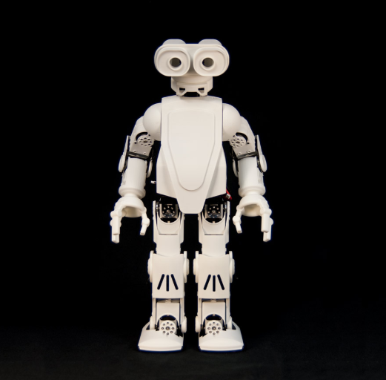
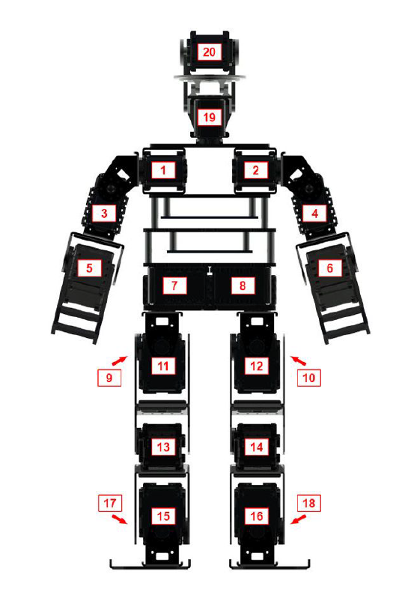
HR-OS5: Brief Introduction

Slide 7
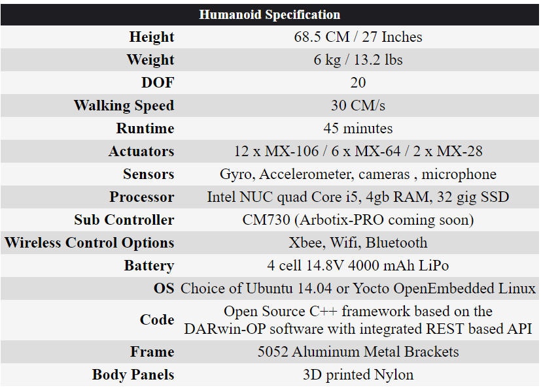
HR-OS5 Specifications

Slide 8
Dynamixel Servos
The Dynamixel servo actuator from Robotis has an onboard microprocessor to facilitate bus communication, positional feedback, temperature & load monitoring.
TTL serial communication allows for daisy-chainable bus connections.
In addition, the Dynamixel’s onboard MCU has a set of user customizable features, allowing users to tune the servos in specifically for their application.
Dynamixel servos configuration can be managed by using Dynamixel Wizard.

Slide 9
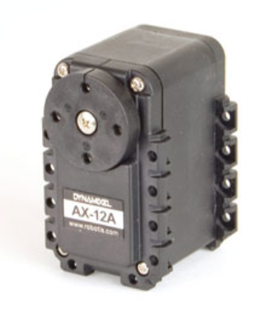
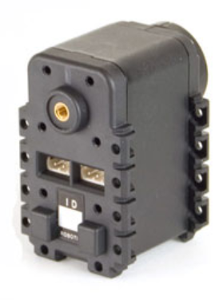
Dynamixel: Specifications
Dedicated onboard MCU
Adjustable torque, speed, and response
Position, load, voltage, temperature feedback
Daisy-chainable Serial Communication
Wide range of sizes, strengths, and communication options
Modular mounting design with comprehensive brackets and frames
3D models, dimensional drawings, full documentation available

Slide 10
Current Progress
Installed and configured ROS environment.
Completed ROS Beginner and Intermediate level tutorials for getting familiar with ROS.
Successfully controlled Dynamixel servo motor with the help of ROS Dynamixel tutorials.
Configured Servo motors for different speeds and degree of rotation.

Slide 11
Proposed Methodology
To write a proper Guideline document describing set-up and configuration of Dynamixel servo motor.
Controlling the Dynamixel servos on the actual robot to indicate head/arms motions, and other emotional behaviors with whole body of the Robot.

Slide 12
Problems Faced
Dynamixel set-up and configuration : As not much material is available on the internet.
Faulty hardware: The hardware provided to us USB2Dynamixel, was not working. Thus, we ordered new U2D2 dongle.

Slide 13
Future Goals
Demonstrating robot’s standard walking motion.
Synchronizing all the body part movements.

Slide 14

Thank You

